Slide 1


Tebong Roland
DSC650
Architectural Design Presentation

Slide 2
Pressing Problem and Current Challenges Faced by the Global Bank.
Pressing Problems
The pressing problem faced in this scenario is the increasing fraudulent activities ranging from unauthorized transactions to money laundering. This issue leads to financial losses for the bank, reputational damage, and potential legal repercussions for non-compliance with regulations.
Current Challenges Faced by the Global Bank.
Real-time detection: Processing vast amounts of daily transactions in real-time to identify fraudulent activities before they cause damage.
Behavioral analysis: Accurately identifying unusual patterns and anomalies in user behavior that might indicate fraudulent intent.
Automated blocking: Implementing a dynamic system to automatically block high-risk transactions while minimizing false positives that inconvenience legitimate users.
Security notifications: Providing personalized security alerts to users based on their transaction behavior and location, striking a balance between informing and avoiding unnecessary alarm.
Regulatory compliance: Ensuring adherence to global regulations regarding money laundering and fraud detection, which requires comprehensive data processing and reporting capabilities.
These challenges highlight the need for a robust, scalable, and efficient architecture that leverages modern technologies to address the evolving landscape of financial fraud.

Slide 3
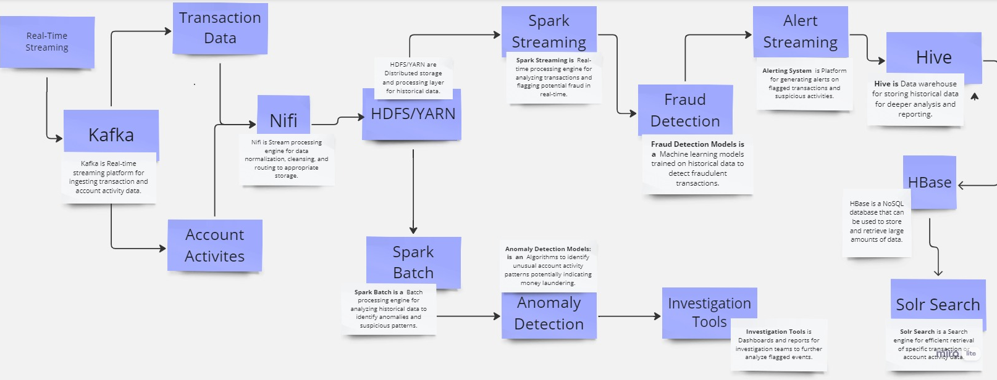
High-level architecture diagram

Slide 4
Data Flow and Real-time Analysis
Data Ingestion
Kafka acts as a high-throughput streaming platform, ingesting real-time credit card transactions, account logins, and other relevant data.
NiFi ingests historical data from various sources like transaction logs, customer profiles, and external fraud intelligence feeds into HDFS, the distributed storage system.
Data Processing
Spark Utilizes YARN, the resource manager, to run parallel processing tasks on HDFS data. Spark analyzes transactions, identifying anomalies and suspicious patterns through machine learning algorithms.
Hive Enables querying of historical data stored in HDFS using SQL-like syntax. Analysts can identify trends and patterns across historical data to refine fraud detection models.
HBase Stores real-time data with low latency for fast lookups. Spark can access HBase for real-time enrichment of transaction data with customer information or past fraud flags.
Fraud Detection & Alerting
Solr Indexes enriched transaction data, enabling fast search and retrieval by analysts investigating flagged transactions.
Alerting: When a transaction is flagged as fraudulent, alerts are sent to security teams in real-time using Kafka or other notification systems.
Interactive Analysis: Hive and Solr enable analysts to interactively explore data, validate alerts, and investigate suspicious activities using tools like Tableau or Kibana.

Slide 5
Data Storage, Retrieval, and Advanced Analysis (The importance of HDFS, Hive, HBase, and Solr )
HDFS stores vast amounts of data.
Hive analyzes historical data for trends and patterns.
HBase handles real-time data for immediate fraud detection.
Solr facilitates fast and insightful search for investigation.
Solr excels at indexing large volumes of enriched transaction data, including real-time information from HBase and historical data from Hive. This indexed data allows for lightning-fast searches based on various criteria like account numbers, transaction amounts, locations, timestamps, and even specific keywords associated with suspicious activity.
Solr can be configured to send alerts in real-time when specific search criteria are met. This can include detecting transactions exceeding certain thresholds, originating from unusual locations, or matching known fraud patterns. These alerts enable immediate investigation and potentially stop fraudulent activities before they succeed.

Slide 6
Benefits and Conclusion (Advantages of the proposed solution)
Mitigating fraud risks
Early detection and prevention use in Catching fraud attempts before they succeed can significantly reduce financial losses.
Improved risk assessment By understanding patterns of fraudulent activity, the system can better identify high-risk transactions and accounts.
Targeted resources can be focused on investigating suspicious activity rather than manually reviewing all transactions.
Enhancing customer trust
Increased security; Customers feel more secure knowing their information and finances are protected.
Faster response to fraud; Promptly addressing fraudulent activity builds trust and confidence.
Transparency and communication by Keeping customers informed about fraud prevention efforts demonstrates the bank's commitment to their safety.
Ensuring compliance
Regulatory adherence: Effective fraud detection helps meet industry regulations and standards.
Reduced regulatory fines: Proactive fraud prevention can avoid penalties for non-compliance.
Improved audit trails: Detailed monitoring and reporting facilitate comprehensive audits.

